Slide 1

Requirements Specification with Use Cases
Notes:
‹#›

Slide 2
What is a Use Case?
“A use case describes sequences of events between an actor and a system that yield a result of value to the actor” (L&W p. 149)
System behavior is how a system acts and reacts – “scenarios”
The outwardly visible & testable activity of a system
System behavior is captured in use cases.
Use cases describe the system, its environment, and the relationship between the system and its environment.
A use case is a template for a collection of related scenarios; or scenarios can be seen as instances of use cases.
Scenario 2
Log on to system.
Enter subject in search.
Invalid subject.
Re-enter subject.
Get course list.
Display course list.
Select courses.
Confirm availability.
Display final schedule.
Scenario 1
Log on to system.
Enter subject in search.
Get course list.
Display course list.
Select courses.
Confirm availability.
Display final schedule.
Register for Courses

Slide 3
Use Case Model +
Use-Case Model
Glossary
Actors
Use Cases
...
Supplementary
Specification
Use-Case Specifications

Slide 4
The Use Case Model
A Use Case Model Consists of:
Use Case Diagram: Actors, Use Cases, Use Case Relationships
Use Case Specification: A textual description of the use cases
A use case diagram:
A use case diagram uses use cases, actors and use case relationships to define a system's behavior
Defines what a system (subsystem, class, or interface) does.
Defines system communication with its environment, as represented by actors.
Does NOT define how a system operates or imply sequence.

Slide 5
Use Case Scenarios and Specifications
Specification: A structured natural language narrative that identifies:
Objective: Every use case must have a goal the Primary Actor is trying to achieve
Primary Actor: one who performs the trigger event
Trigger Event: an event that causes the system to respond
Secondary Actor(s): participate in interactions in the use case; often a system
Business Rules / Constraints: as they apply; often promoted to the Supplementary Specification
Pre/Post Conditions: predicates that must exist before/after the Happy Day case
One or more scenarios…
A scenario is an instance of a use case
The normal basic flow called the “Happy Day” case
A use case may have several alternative flows
Regular variants
Exceptional flows handling error situations
Copyright © 2000 Rational Software, all rights reserved

Slide 6
Glossary and Supplementary Specification
Course Registration System Glossary
1. Introduction
This document is used to define terminology specific to the problem domain, explaining terms, which may be unfamiliar to the reader of the use-case descriptions or other project documents. Often, this document can be used as an informal data dictionary, capturing data definitions so that use-case descriptions and other project documents can focus on what the system must do with the information.
2. Definitions
The glossary contains the working definitions for the key concepts in the Course Registration System.
2.1 Course: A class offered by the university.
2.2 Course Offering: A specific delivery of the course for a specific semester – you could run the same course in parallel sessions in the semester. Includes the days of the week and times it is offered.
2.3 Course Catalog: The unabridged catalog of all courses offered by the university.
Glossary
(FURPS model)
Functionality*
Usability
Reliability
Performance
Supportability
Design constraints…etc.
Since the focus is on the what
(functionality), you can use use cases
even if you are not doing OO
Supplementary
Specification

Slide 7
USE CASE DIAGRAM UML NOTATION

Slide 8
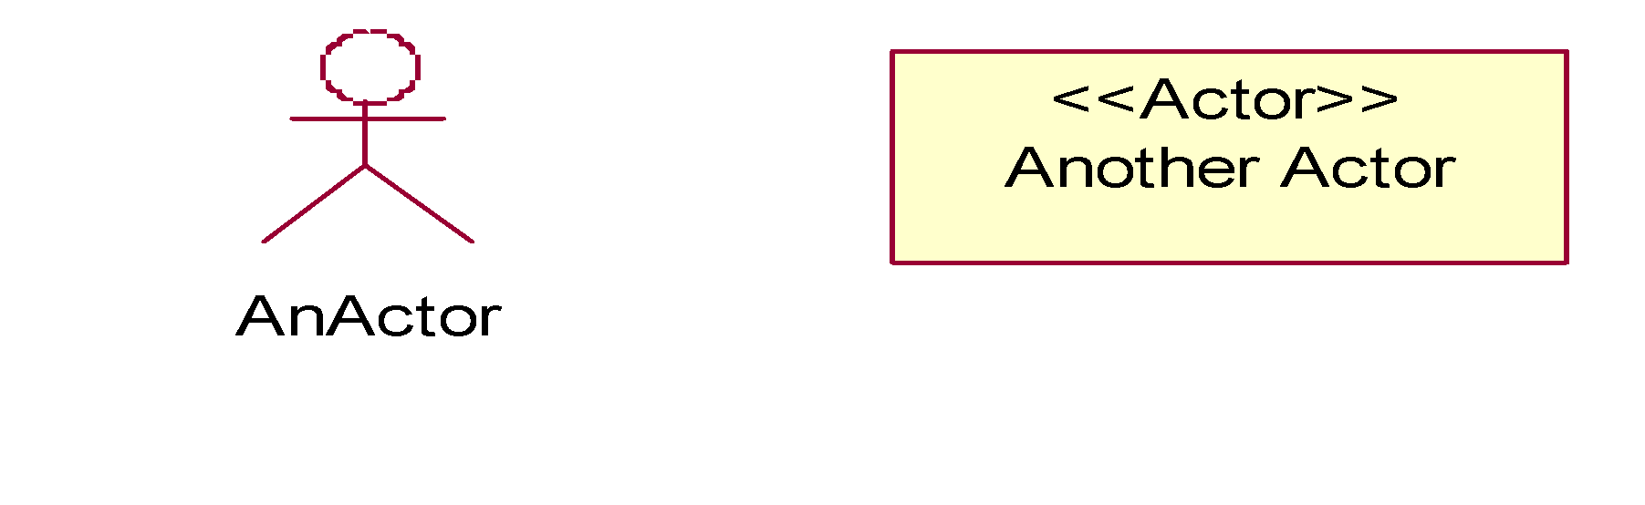
Use Case Notation: Actor
“An actor defines a coherent set of roles that users of an entity can play when interacting with the entity” – UML
Representing something outside the system that interacts with it
Represented as a “stick man” figure
By definition, an actor is a stereotyped class where the stick man icon is used for graphical representation

Slide 9
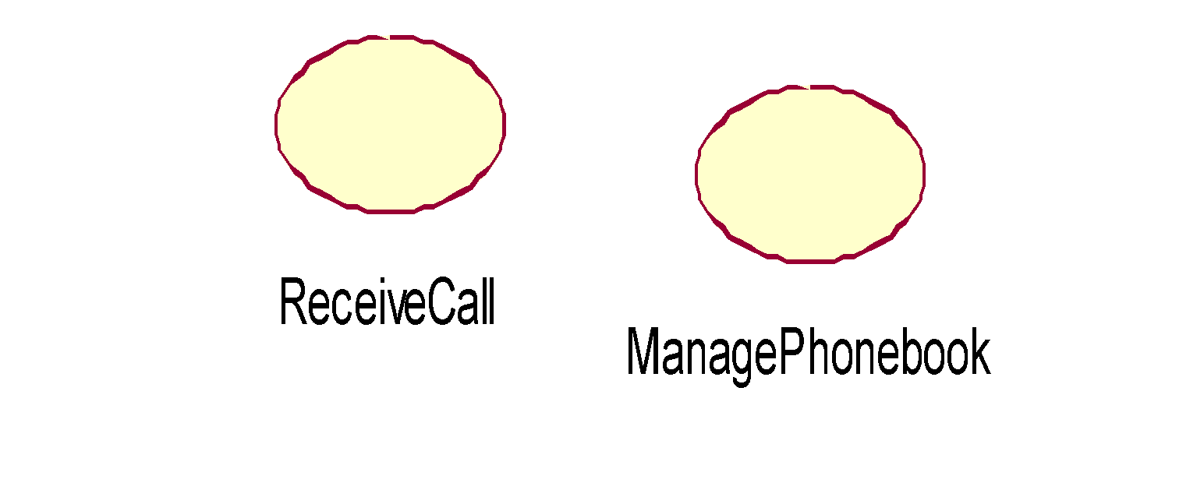
Notation: Use Case
“A coherent unit of functionality provided by a system, a subsystem, or a class as manifested by sequences of messages exchanged among the system (subsystem, class) and one or [actors] together with actions performed by the system (subsystem, class)” -- UML
Represented as an ellipse containing the use case name
Optional:
Extension points
[As a classifier] Compartments for attributes and operations

Slide 10
Notation: Communicates-Association
A channel of communication between an actor and a use case.
A line is used to represent a communicates-association.
An arrowhead indicates who initiates each interaction.
No arrowhead indicates either end can initiate each interaction.
Actor 1
Use Case
Actor 2
Actor 3

Slide 11
USE CASE SPECIFICATION

Slide 12
Use Case Template (one possible version)
USE CASE <<Enter Use Case Number>>: <<Use Case Title>>
Objective: <<Enter the goal of the use case>>
Primary Actor: <<Enter ID and Name of Actor causing the Trigger event>>
Trigger: <<Action performed by the Primary Actors>>
Secondary Actors: <<actors affected by the outcome or secondary participants (not causing the Trigger)>>
Preconditions: <<The state of the environment required in order to activate this use case.>>
Post Condition(s): <<Enter the expected resulting state from the Main Success Scenario.>>
MAIN SUCCESS SCENARIO
<<Enter a numbered list of interactions needed to achieve the objective of the use case>>
Extension Points: <<Often identified inline; alternatively may be catalogued in its own subsection>>
Variations
Variation ID: <<Enter variation ID, should be UC-ID plus a VAR-XX suffix>>
<<Enter numbered list of variations to the steps in the main process above. Indicate whether the variation is an addition, replacement, or removal of interactions from main flow>>
<<If the variation requires different preconditions or affects changes in the postconditions, be sure to note the changes here. Typically neither is required for a non-failure variation, though sometimes there are additional pre/postconditions.>>
Failure Variations
Variation ID: <<Enter variation ID, should be UC-ID plus a VAR-XX-F suffix>>
<<Enter bulleted list of possible variations to the steps in the main process above>>
<<Indicate the postconditions associated with this negative outcome, and whether the use case is reentrant (you can repeat subflows or main success scenario or some alternate action as recovery)>>
Business rules
<<Enter Business Rules. If they are applied across more than 1 use case then they are moved to the catalog area.>>
Notes: <<free form text here. Note this must not have requirements, but is usually more explanatory>>

Slide 13
Use Case Template Example
Use Case UC-SAKGC-120108 -1: Student Sends Busy Notification
Objective: Notify external users of busy times when scheduling a new appointment
Primary Actor: External User
Trigger: External user tries to add new appointment to Google Calendar of a Student
Secondary Actors: Google Servers, Student
Preconditions: 1. External User is logged on to Sakai and Google Calendar
2. External User has access to Students Calendar
3. Student has appointment at same time External User is trying to make a new appointment
Post Condition: 1. External User receives a busy notification
MAIN SUCCESS SCENARIO
1. External User tries to add a new appointment to Student’s calendar in Google Calendar
2. System checks authorizations for Student’s calendar for External User
3. System checks Student’s calendar for the specified time/day
3. External User receives busy notification
VARIATIONS
Variation ID: UC-SAKGC-120108-1-01
1. External User tries to adds appointment to Sakai Schedule
2. Appointment migrates to Google Calendar
3. Google calendar sends busy notification

Slide 14
USE CASE NOT-SO BEST PRACTICES

Slide 15
Avoid Functional Decomposition
Functional Decomposition: Breaking down a problem into small, isolated parts. The parts work together to provide the functionality of the system.
Often do not make sense in isolation.
Use cases are NOT functional decomposition.
Keep functionality together to describe a complete use of the system.
Provide context.
FOCUS ON THE USER’S GOAL
Symptoms
Very small use cases
Too many use cases
Uses cases with no result of value
Names with low-level operations
“Operation” + “object”
“Function” + “data”
Example: “Insert Card”
Difficulty understanding the overall model
Corrective Actions
Search for larger context
“Why are you building this system?”
Put yourself in user’s role
“What does the user want to achieve?”
“Whose goal does this use case satisfy?”
“What value does this use case add?”
“What is the story behind this use case?”

Slide 16
Functional Decomposition Example
Process Transaction
Insert Card
Bank Consortium
Enter PIN
Customer
Enter Amount
Select Withdraw Cash
Select Account Balance

Slide 17
Functional Decomposition Example
A Corrected Example
Withdraw Cash
Transfer Funds
Bank Consortium
Customer
Deposit Funds

Slide 18
USE CASE DEVELOPMENT GUIDELINES

Slide 19
How to do it:
Step 1. Identify and Describe the Actors
Identify actors and their needs
What computers, subsystems and people will drive our system?
An “actor” is anything that interacts with the system.
Actors have goals; these goals drive Use Case development
An alternative way to think about Use Cases are not just as a template for related scenarios, but instead as a template for Actor interactions.
Result: a list of actors and their goals
Step 2. Identify the Use Cases and write a brief description
What does each actor need our system to do?
Each need shows up as a result in our system.
You are still breadth-oriented for now
Important to have a name and a description of each use case, but nothing more (yet)
At this point you can have high-level “bubble diagram”
RESULT: Catalog of current use cases

Slide 20
How to do it:
Step 3. Identify Actor to Use Case relationships
Use cases may involve multiple actors
Use cases may affect multiple actors (indirectly)
RESULT: Catalog with full scope identified
Step 4. Outline the Individual Use Cases
For each use case, write the simple case: goal delivers.
The main success scenario, the “happy day” case.
Easiest to read and understand.
Everything else is a complication on this.
Capture each actor’s intent & responsibility, from trigger to completion
Say what information passes between them.
Number each line.
Result: readable description of system’s functions.

Slide 21
How to do it:
Step 5. Refine the Use Cases
Identify alternate scenarios
Alternate success scenarios
Scenarios that may not be common but are not unanticipated
Failure scenarios
Usually, each step can fail.
Also need to consider what happens if a precondition does not hold
Result: list of alternate scenarios per use case.
Step 6. Verify & Validate the Use Cases (not in text)
Did you get all of the use case?
Are they (especially the highest priority ones) all correct?
Ensure stakeholder goals are all present or “covered”, and that none of the goals are contrived or not representative of a customer need.
RESULT: A complete set of Use Cases with customer, user, all stakeholder buy-in.

Slide 22
Use Case Guidelines
Use Case Development is an iterative process
Steps 1-3 in particular focus on the breadth of the catalog
Steps 4-5 focus on depth of prioritized use cases in the catalog
Note: Other parallel activities can and should be going on:
UI prototyping
Architecture document drafts and initial interface code
Resource planning, scheduling, etc.
A well-structured use case diagram:
Communicates a single aspect of a system's use case view.
Contains only use cases and actors essential to understanding that aspect of the systems behaviour that the diagram is modelling.
Is consistent in its level of abstraction.
Is not so minimalistic as to misinform the reader
this is NOT just for developers

Slide 23
Use Case Tips
Use Case No-No’s
Use cases are not “flowcharts”
Do not use in isolation!
Do your Use Cases in “phases”
The 6 steps from before – “lather, rinse, repeat”
After identifying a full catalog of refined use cases, you can start to “factor” your use cases
Factoring use cases
Use cases so far are independent
Document use case as a statement of user need
Have not yet discussed how they relate to each other
Use case “analysis”
Considers how use cases relate to each other
Begins to partition the problem space
We suggest 2 use case models, one after elicitation (SRS), then another at the start of analysis (Architecture doc)

